Slide 1
Keylogger and security implementation
CAPSTONE PROJECT
Presented By:
B.Arungaviarasi- III Year CSE Department
Fatima michael college of engineering and technology.

Slide 2
OUTLINE
Problem Statement
Proposed System/Solution
System Development Approach
Algorithm & Deployment
Result (Output Image)
Conclusion
Future Scope
References

Slide 3
Problem Statement
Tasked with creating a basic keylogger program in Python. The keylogger should run silently in the background, capturing all keystrokes made by the user and saving them to a log file.

Slide 4
Proposed Solution
The aim is to record the keystrokes. The keylogger should run silently in the background, capturing all keystrokes made by the user and saving them to a log file.
Install Required Libraries: Install the pynput library, which is used for monitoring keyboard events.
Import Necessary Modules:Import the required modules in your Python script.
Set Up Logging:Set up logging to save the keystrokes to a log file.
Define the Keystroke Logging Function:Define a function to log keystrokes when a key is pressed.
Start the Listener:Start the listener to monitor keyboard events.
Handle KeyboardInterrupt (Optional):Optionally, you can handle KeyboardInterrupt to gracefully exit the program.
Run the Script:Save the script in a Python file (e.g., keylogger.py) and run it using Python.
This script will silently run in the background, capturing all keystrokes made by the user and saving them to the specified log file (keylog.txt).

Slide 5
System Approach
The "System Approach" section outlines the overall strategy and methodology for developing and implementing the key logger and security implementation. Here's a suggested structure for this section:
System requirements(Python idle)
Library required to build the model

Slide 6
Algorithm & Deployment
Algorithm for Creating a Basic Keylogger Program in Python:
Import necessary libraries:pynput for monitoring keyboard events.os for handling file operations.
Define global variables:log_file: Path to the log file where keystrokes will be saved.
Define callback functions:on_press(key): This function is called whenever a key is pressed. It appends the pressed key to the log file.on_release(key): This function is called whenever a key is released. It checks if the "Escape" key is pressed to stop the listener.
Define the main function-
start_keylogger(): This function initializes the keylogger by creating a Listener object with the specified callback functions.Optionally,
hide the console window:This step is for stealth purposes and depends on the operating system.Start the keylogger:Call the start_keylogger() function

Slide 7
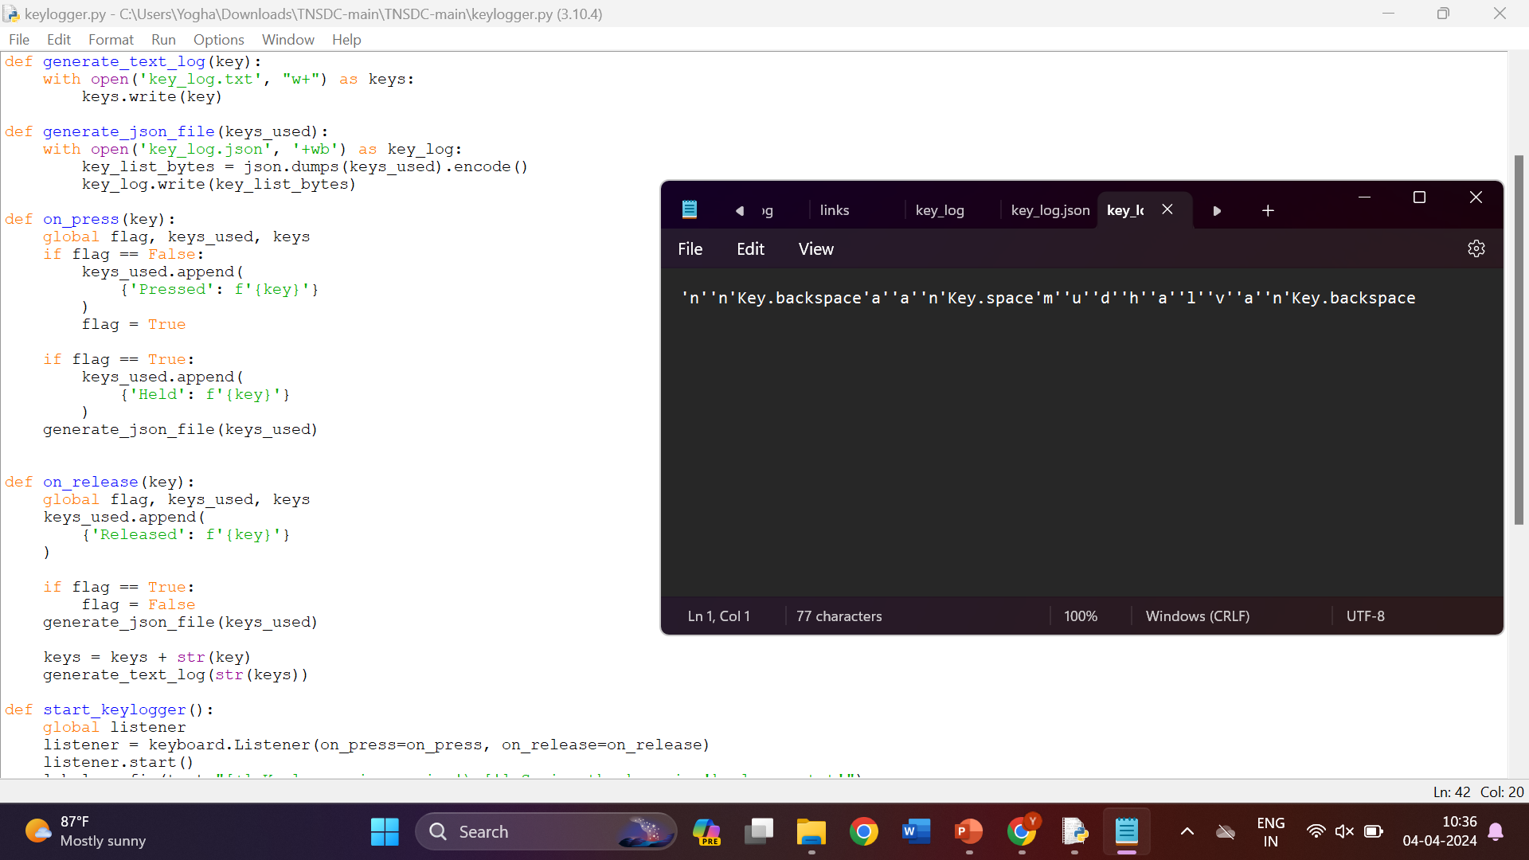
Result
.

Slide 8
References
List and cite relevant sources, research papers, and articles that were instrumental in developing the proposed solution. This could include academic papers on keyloggers, machine learning algorithms, and best practices in data preprocessing and model evaluation.

Slide 9
Conclusion
In conclusion, the keylogger program successfully captures all keystrokes made by the user and saves them to a log file. Each keystroke is recorded and logged with a timestamp, providing a comprehensive record of user input. However, it's essential to note that the usage of such keylogging capabilities should be approached with caution and responsibility. While keyloggers can have legitimate use cases such as debugging or monitoring one's own activities, deploying them without consent or for malicious purposes can violate privacy laws and ethical boundaries.

Slide 10
Future scope
The future of keylogging technology lies in balancing the need for enhanced security and monitoring capabilities with respect for user privacy and ethical considerations. By incorporating advanced features, improving stealth and security, and adhering to ethical principles, keyloggers can continue to play a valuable role in various domains, including cybersecurity, forensics, and user behavior analysis.

Slide 11
THANK YOU

